Slide 1
Generating Code Faster Than You Can Say 'Typescript'!
Par Michael Masson - 29 novembre 2024

Slide 2







Code Generation ?
gRPC
HUGO
AWS CDK
graphQL
VSCode
Copilot
Typescript

Slide 3
Types of Code Generation
Intellisense
Scaffolding
AI Assisted / LLM-based
Template-based
Compilers / Transpilers
DSL-based
Macro-based
Model / Spec Driven
Behavioral / Test Case
Rule-based / Reverse Engineering
Code Transformation

Slide 4
Api Code Gen
Utiliser le code gen pour un api

Slide 5


Gestion de Poulailler par api BKKAKK!

Slide 6
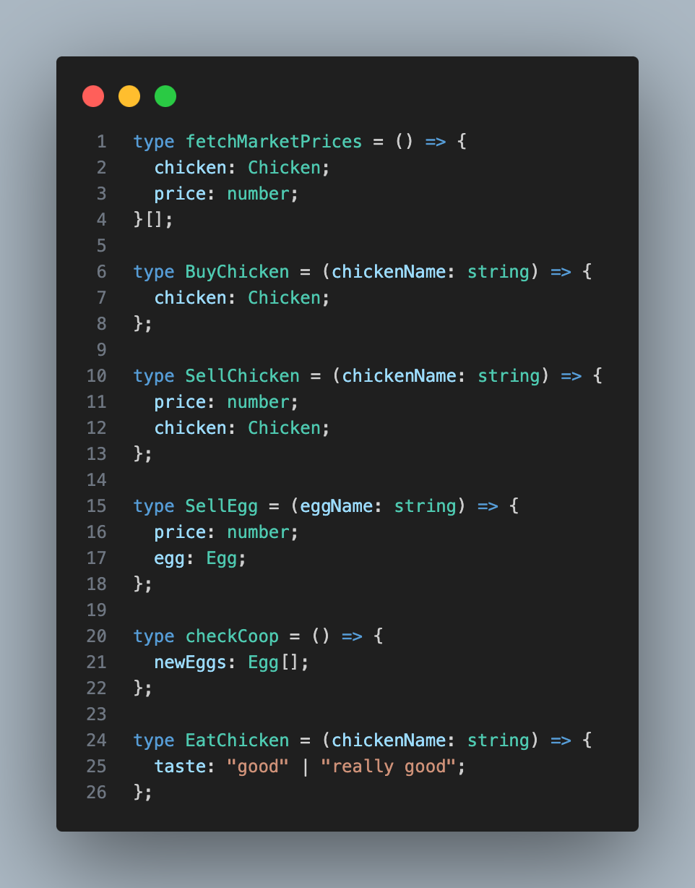
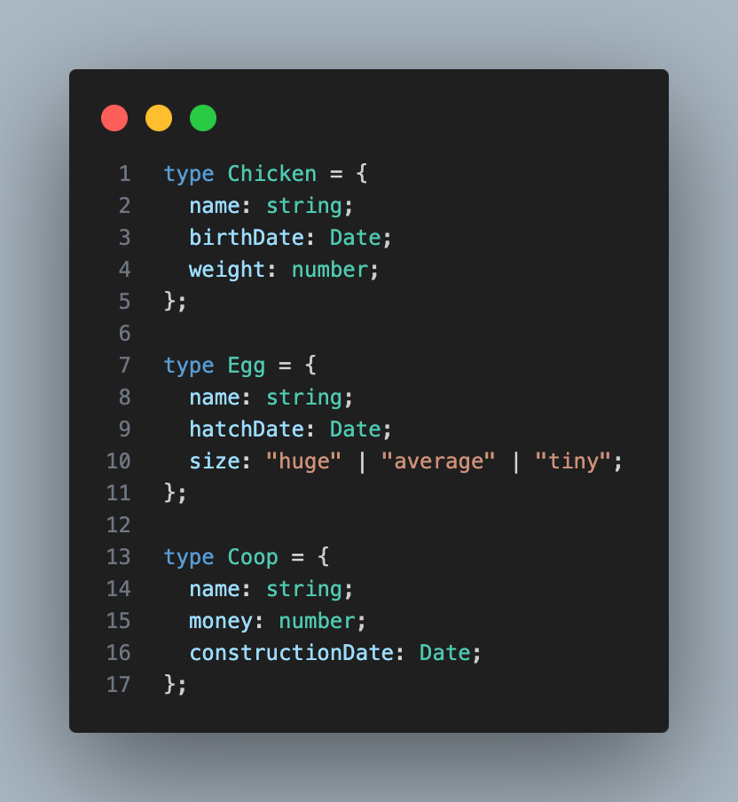

Slide 7
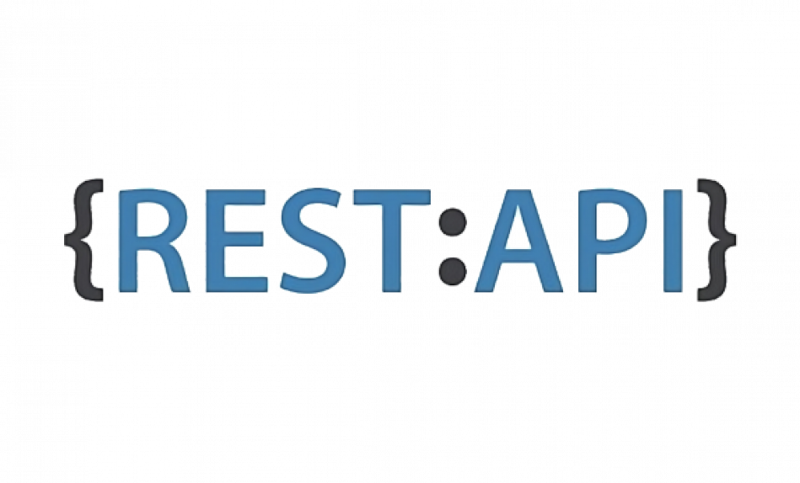



Specifications

Slide 8
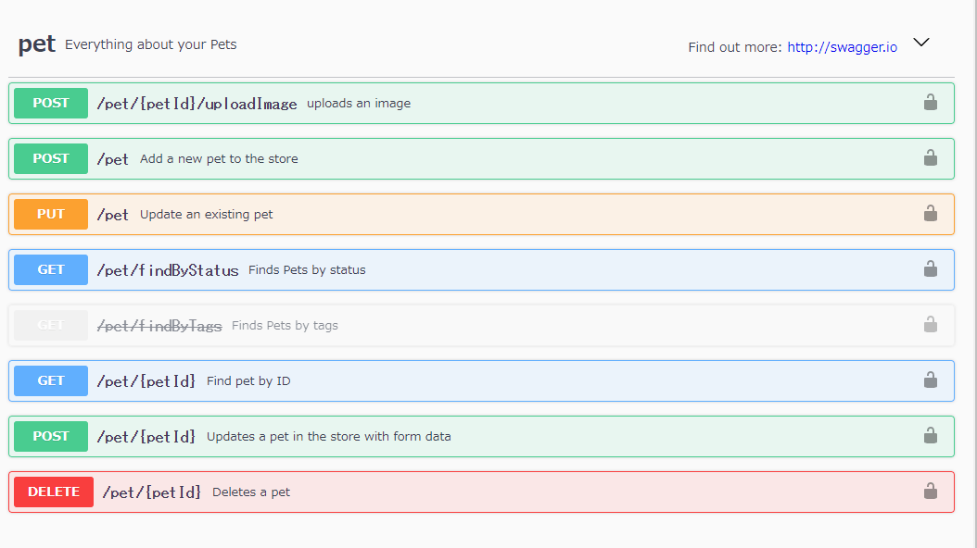
OpenApi

Slide 9

Openapi Generator
Server Code
Mock servers
Client Code
Tests Generation

Slide 10








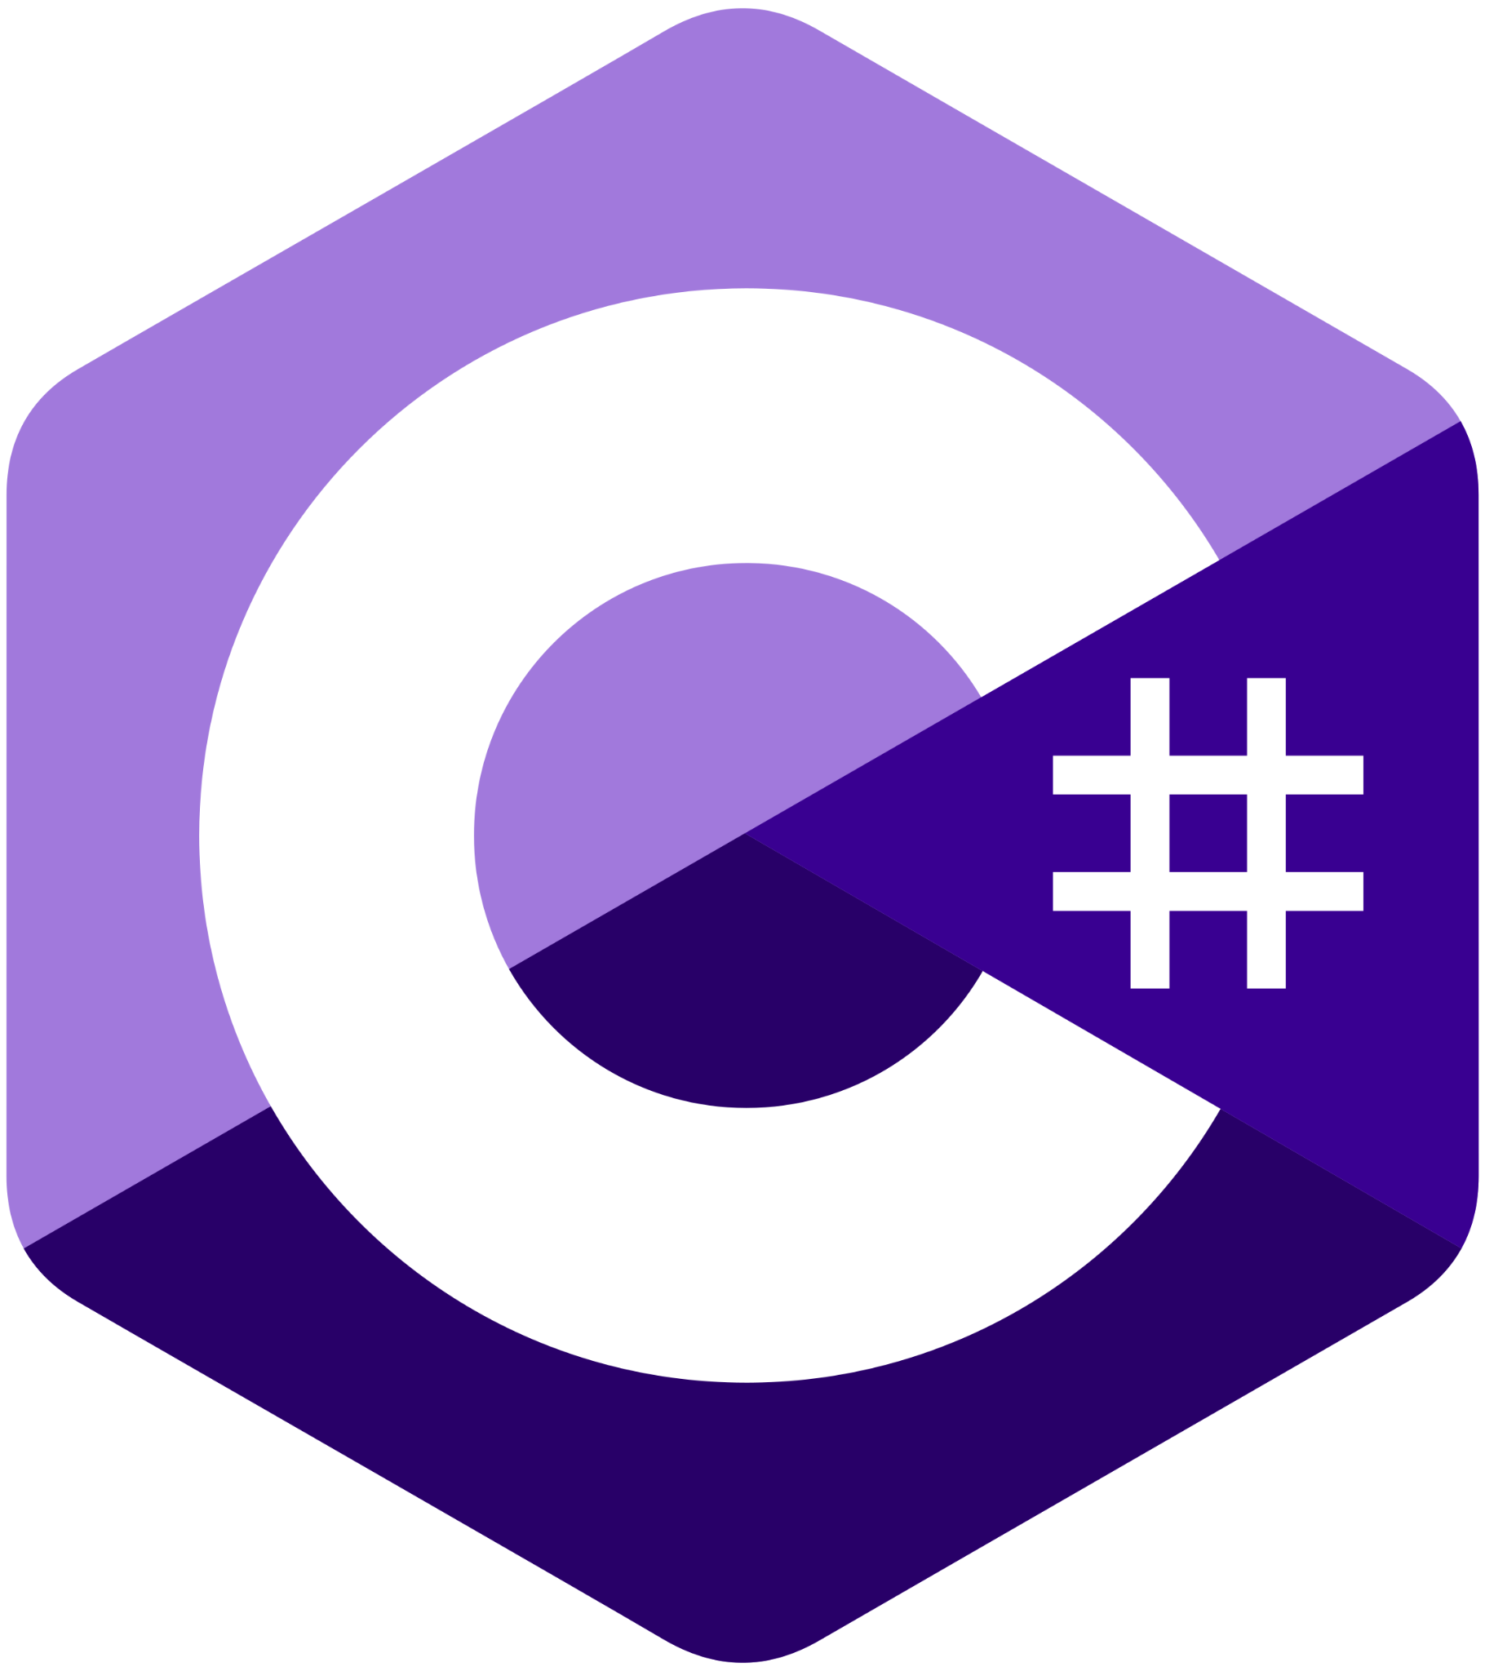


Generation Pipeline
Code
Schemas
Definition
Doc
Db
Clients & Server

Slide 11

Opapi

Slide 12
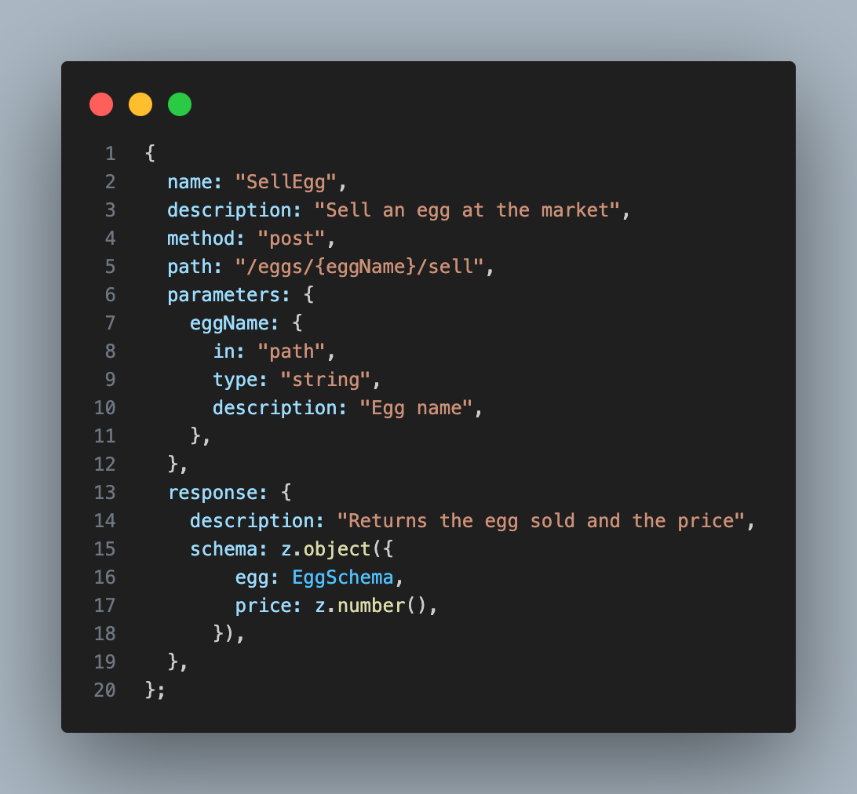
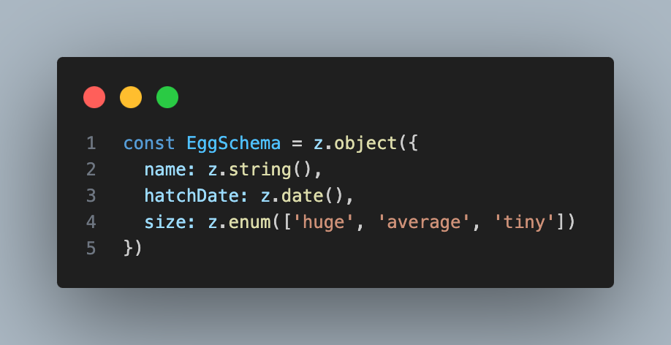

Slide 13
What is next ?

Slide 14

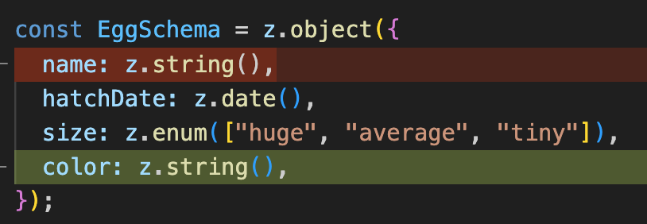

Slide 15

Team is bigger ?

Slide 16

Spotlight
Conventions
Api Style
Linting

Slide 17
My game is slowing down ?

Slide 18
Multiple Servers
API ROUTER
Coop Api
Market Api
Coop
Market
Chicken
Chicken Api

Slide 19

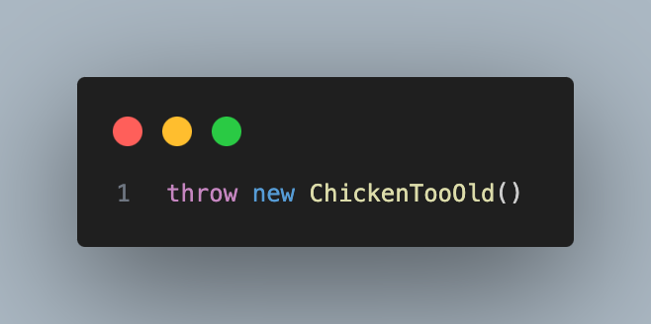
Handling Errors
API ROUTER
Coop Api
Market Api
Chicken Api

Slide 20
UI (Zui)
Code
Schemas
Forms
Data
Relation

Slide 21

Best Game Ever

Slide 22
Advantages / Disadvantage ?
Fast & Efficient
Consistent
Up to date
Better designs
Focus Business Logic
Reduce Coupling
Reduce Cognitive Load
Bigger Errors
Ugly Code
Less Control
Harder to Debug
Harder to personalize
Tooling takes time

Slide 23


Speakeasy
Fern

Slide 24
Merci!
Questions ?

